Slide 1
Introduction to Web Development
History

Slide 2
Network Basics
Two fundamental types of networks
Circuit switching
Packet switching
A
A
C
C
B
B
A
switch
switch
C
B

Slide 3
Network Basics
Advantages and disadvantages of both
Bandwidth
Collisions
Virtually all networks using packet switching
Telephone networks (older, not Voice over IP or VOIP)
Circuit-switched
ARPANET
First public packet-switched computer network (1969-1989)
Used packets, or smaller chunks of a message, routed by address

Slide 4
Network Basics
Early Networks
ARPANET (1969)
X.25 (1974)
USENET (1979)
Lack of similarity slowed growth
Need for standards lead to protocols
Formal set of publicly available rules
Transmission Control Protocol/Internet Protocol (TCP/IP) (1981)

Slide 5
Birth of the World Wide Web
Internet from the 1980’s and early 1990’s looked much different
Non-standard
Text based clients
Invention of the World Wide Web (www)(1989)
CERN (European Organization for Nuclear Research)
Robert Cailliau – proposed the first hypertext system (pre-www)
Sir Timothy John Berners-Lee – proposed and implemented communication between a HyperText Transfer Protocol (HTTP) client and server

Slide 6
Components of the World Wide Web
URL – Uniform Resource Locator
HTTP – HyperText Transfer Protocol
HTTP web server (software)
HTTP web client or browser (software)
HTML – HyperText Markup Language

Slide 7
Evolution of Web Servers
CERN httpd (1990 – 1996)
NCSA HTTPd (1993 – 1995)
Apache HTTP Server (1995 - )
Internet Information Services (1995 - )
Jigsaw (1996 – 2007)
…
WEBrick (2003 - )
GlassFish (2005 - )
Python HTTP server (2006 - )
Node.js HTTP server (2009 - )

Slide 8
Evolution of Web Browsers
Line Mode Browser (1990 – 2006)
Mosaic (1993 - 1997)
Netscape Navigator (1994 - 2008)
Microsoft Internet Explorer (1995 - 2021)
Mozilla Firefox (2002 - )
Apple Safari (2003 - )
Google Chrome (2008 - )
Microsoft Edge (2015 - )
See List of Web Browsers

Slide 9
Evolution of Standards
World Wide Web Consortium (W3C)
Berners-Lee helped found in 1994
International Standards Organizations for the World Wide Web
Internet Engineering Task Force (IETF)
International Standards Organization for the Internet
Responsible for the technical standards that comprise the Internet protocol suite (TCP/IP)
Request for Comments
Publication archiving the lists of all Internet and WWW protocols, concepts and standards.
Ex: IETF

Slide 10
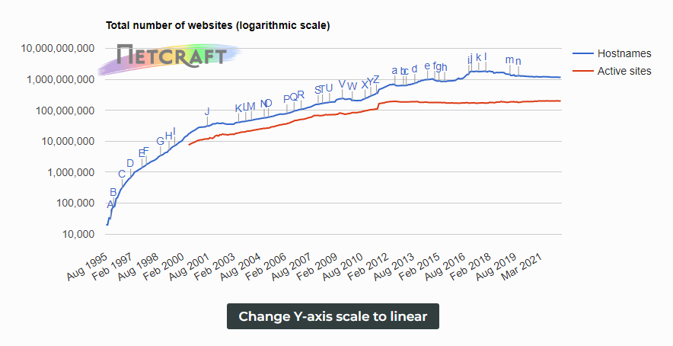
Growth of the Web
Source: Netcraft (Web Server Survey)

Slide 11
Future of the Web
Web 1.0
Web 2.0
Web 3.0 a.k.a. Semantic Web
Sociological impacts of the Web
Socioeconomic
Sociotechnical
Educational aspects
Accessibility aspects

